Slide 1
Analysis Model, Design Model, Implementation Model, Test Model
Sita Sapkota
Roll no: 8

Slide 2
Analysis Model
Analysis Model is a technical representation of the system.
Acts as a link between system description and design model.
In Analysis Modelling, information, behavior, and functions of the system are defined and translated into the architecture, component, and interface level design in the design modeling.

Slide 3
Objectives of Analysis Model
Establish a way of creating software design.
Describe the requirements of the customer.
Define a set of requirements that can be validated, once the software is built.

Slide 4
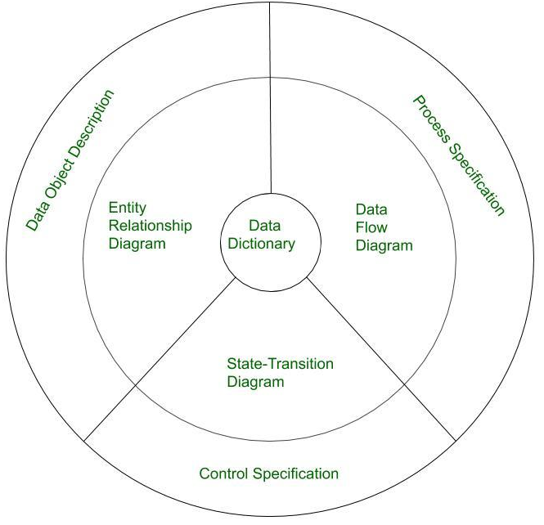
Diagram Showing Elements of Analysis Model

Slide 5
Elements of Analysis Model
Data Dictionary:
It is a repository that consists of a description of all data objects used or produced by the software.
It stores the collection of data present in the software. It is a very crucial element of the analysis model.
It acts as a centralized repository and also helps in modeling data objects defined during software requirements.

Slide 6
Elements of Analysis Model
Entity Relationship Diagram (ERD):
It depicts the relationship between data objects and is used in conducting data modeling activities.
The attributes of each object in the Entity-Relationship Diagram can be described using Data object description.
It provides the basis for activity related to data design.

Slide 7
Elements of Analysis Model
Data Flow Diagram (DFD):
It depicts the functions that transform data flow and it also shows how data is transformed when moving from input to output.
It provides the additional information which is used during the analysis of the information domain and serves as a basis for the modeling of function.
It also enables the engineer to develop models of functional and information domains at the same time.

Slide 8
Elements of Analysis Model
State Transition Diagram:
It shows various modes of behavior (states) of the system and also shows the transitions from one state to another state in the system.
It also provides the details of how the system behaves due to the consequences of external events.
It represents the behavior of a system by presenting its states and the events that cause the system to change state.
It also describes what actions are taken due to the occurrence of a particular event.

Slide 9
Elements of Analysis Model
Control Specification:
It stores additional information about the control aspects of the software.
It is used to indicate how the software behaves when an event occurs and which processes are invoked due to the occurrence of the event.
It also provides the details of the processes which are executed to manage events.

Slide 10
Elements of Analysis Model
Process Specification:
It stores the description of each function present in the data flow diagram.
It describes the input to a function, the algorithm that is applied for the transformation of input, and the output that is produced.
It also shows regulations and barriers imposed on the performance characteristics that are applicable to the process.

Slide 11
Design Model
Design modeling in software engineering represents the features of the software that helps engineer to develop it effectively, the architecture, the user interface, and the component level detail.
The software design process can be divided into the following three levels of phases of design:
Interface Design
Architectural Design
Detailed Design

Slide 12
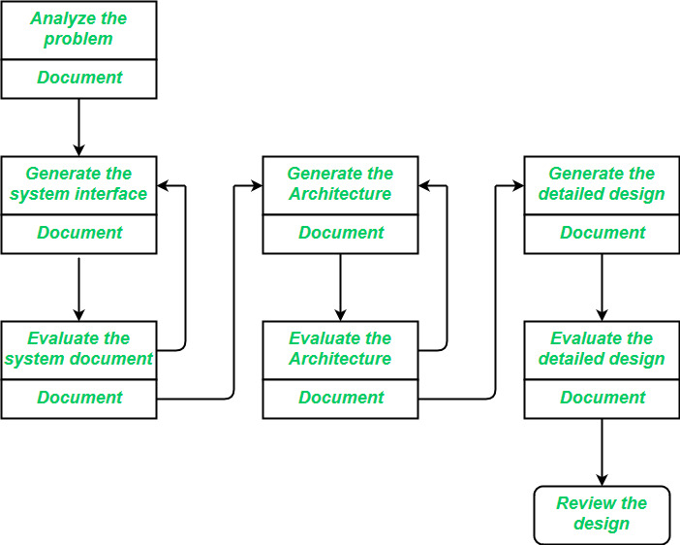
Diagrammatic Representation

Slide 13
Interface Design
Interface design is the specification of the interaction between a system and its environment.
Interface design should include the following details:
Precise description of events in the environment, or messages from agents to which the system must respond.
Precise description of the events or messages that the system must produce.
Specification on the data, and the formats of the data coming into and going out of the system.
Specification of the ordering and timing relationships between incoming events or messages, and outgoing events or outputs.

Slide 14
Architectural Design
Architectural design is the specification of the major components of a system, their responsibilities, properties, interfaces, and the relationships and interactions between them.
Issues in architectural design includes:
Gross decomposition of the systems into major components.
Allocation of functional responsibilities to components.
Component Interfaces
Communication and interaction between components.

Slide 15
Detailed Design
Detailed Design is the specification of the internal elements of all major system components, their properties, relationships, processing, and often their algorithms and the data structures.
The detailed design may include:
Decomposition of major system components into program units.
Allocation of functional responsibilities to units.
User interfaces
Unit states and state changes
Data packaging and implementation
Algorithms and data structures

Slide 16
Comparison of Analysis Model and Design Model
Analysis Model
Design Model
Satisfies functional requirement.
Less effort to develop
Few layer
Dynamic, but not much focus on sequence.
Less formal.
May not be maintained throughout the life cycle
Satisfied both functional and non-functional requirements.
More effort to develop
More layers
Dynamic with much more focus on sequence, concurrency and distribution.
More formal.
Maintained throughout the life cycle.

Slide 17
Comparison of Analysis Model and Design Model
Analysis Model
Design Model
Design-generic (Applicable to several possible design).
A conceptual model because it is an abstraction of the system and avoid implementation issues.
Define the structure that is an essential input to shape the system including design model.
Specific for an implementation
A physical model a blueprint for an implementation.
Define the structure of the system with respect to functional and non-functional requirement of the system.

Slide 18
The Implementation Model
The implementation model answers the question, “How does this work?” It represents how a developer will build the system, website, web app, or something else.
The implementation model consists of the annotated source code and the base for the implementation model is design model.

Slide 19
Test Model
The test model is the last model developed in the system development life cycle.
The fundamental concepts in testing are mainly the test specifications and the test result.

Slide 20
Thank You

